Slide 1

Graph Database --Neo4j Updated 2025-11
Zack Dai
Download this PPT sildes from Github:
https://github.com/Goodman-School/GraphDatabase/blob/main/Graph Database%20Neo4j%202603.pptx

Slide 2
Content
Part1 Graph Database Introduction
Graph Database
Comparison SQL with Neo4j
Use case of Neo4j
Part2 Practice with Neo4j
Neo4j playground online
Import data to Neo4j
Basic Queries
Advanced usage
Appendix: Learning Resources

Slide 3
Part 1
Graph Database Introduction

Slide 4
Graph Database
A graph is composed of two elements: a node and a relationship.
Each node represents an entity (a person, place, thing, category or other piece of data), and each relationship represents how two nodes are associated.

Slide 5
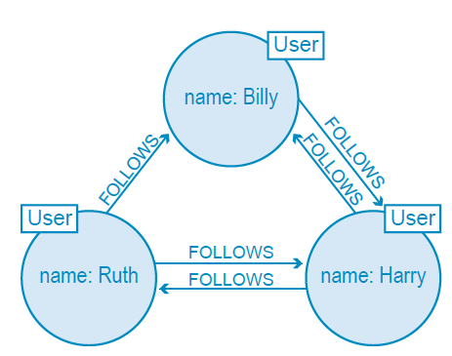
Graph Database
Twitter is a perfect example of a graph database connecting 313 million monthly active users. In the illustration to the right, we have a small slice of Twitter users represented in a graph data model.

Slide 6
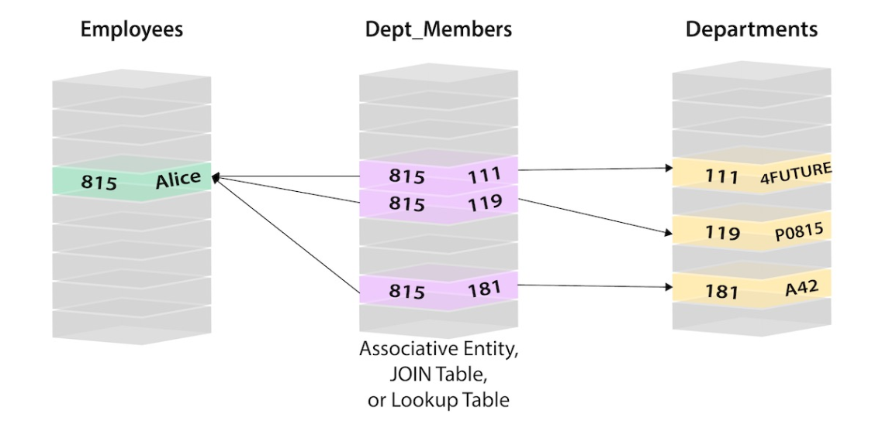
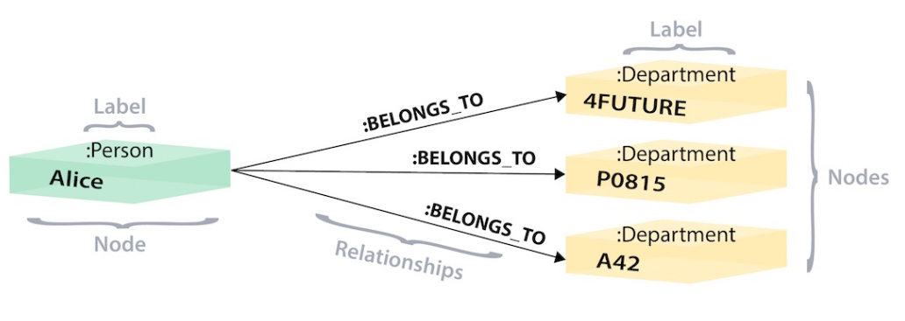
SQL vs NEO4j
SQL
NEO4j

Slide 7
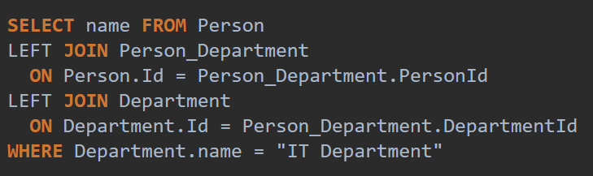
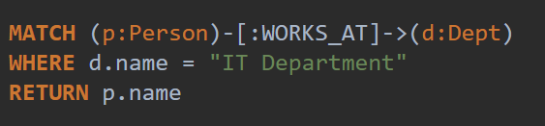
SQL vs NEO4j
SQL
NEO4j

Slide 8
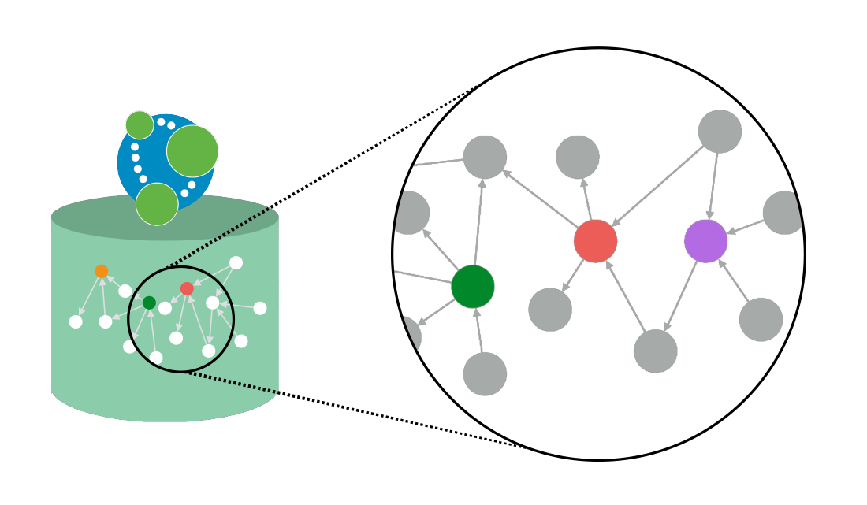
Advantages of NEO4j
Easy to Use
Visualization
Open Source
Fast
Support Network Algorism
Free Training and Certificate!

Slide 9
Neo4j Use Case
Fraud Detection
Knowledge Graph
Network and Infrastructure Monitoring
Recommendation System
Social Network Graph
AI and Analytics

Slide 10
Part 2
Neo4j Sandbox Exploration

Slide 11
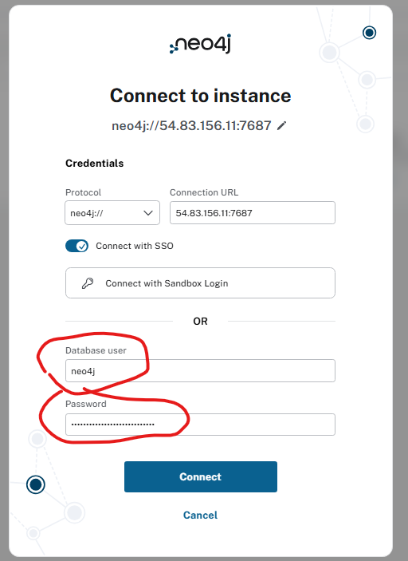
Connect to database
Go to http://52.70.34.0:7474/
Login with credential
(only valid before 2026-03-24)
Username: neo4j
Password:
laps-documentations-dissipation

Slide 12
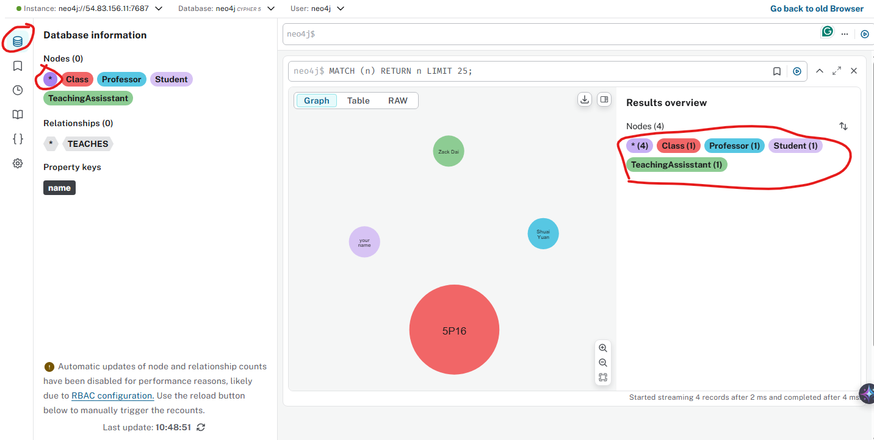
Simple Exploration

Slide 13
Basic Node Queries
Create a Node:
MERGE (s:Student {name:"your name"}) RETURN s
Find your node:
MATCH (s:Student {name:"your name"}) RETURN s
OR:
MATCH (s:Student) WHERE s.name = "your name" RETURN s
Find everyone:
MATCH (s:Student) RETURN s
With a limit:
MATCH (s:Student) RETURN s LIMIT 5
With a sort :
MATCH (s:Student) RETURN s ORDER BY s.name DESC LIMIT 5

Slide 14
Relationship Query
Create Relationship:
MATCHE (s:Student), (c:Class)
WHERE s.name = "your name" AND c.name ='5P16’
MERGE (s)-[e:ENROLLED_IN]->(c)
RETURN s, c, e
Search Relationship:
MATCH (s)-[e:ENROLLED_IN]->(c:Class)
Where c.name = '5P16’
RETURN s, c, e
OR for quick general search:
MATCH (c:Class)-[r]-(n) WHERE c.name = '5P16’ RETURN *

Slide 15
Create VS Match
Create a Node:
CREATE (s:Student {name:"your name"}) RETURN s
Check result:
MATCH (s:Student {name:"your name"}) RETURN s
Add attribute to a node:
MATCH (s:Student {name:"your name"})
SET s.email = 'yourname2@brocku.ca’
RETURN s
How to improve:
1. Use merge instead of create
2. Create unique index:
CREATE CONSTRAINT unique_student_email IF NOT EXISTS FOR (s:Student) REQUIRE s.email IS UNIQUE;

Slide 16
Delete Node
Always check before you delete (IMPORTANT!)
MATCH (s:Student) WHERE elementId(s) = ' The id from previous' RETURN s
When everything confirmed:
MATCH (s:Student) WHERE elementId(s) = ' The id from previous’ DETACH DELETE s
Verify the result:
match (s:Student {name:"your name"}) return s

Slide 17
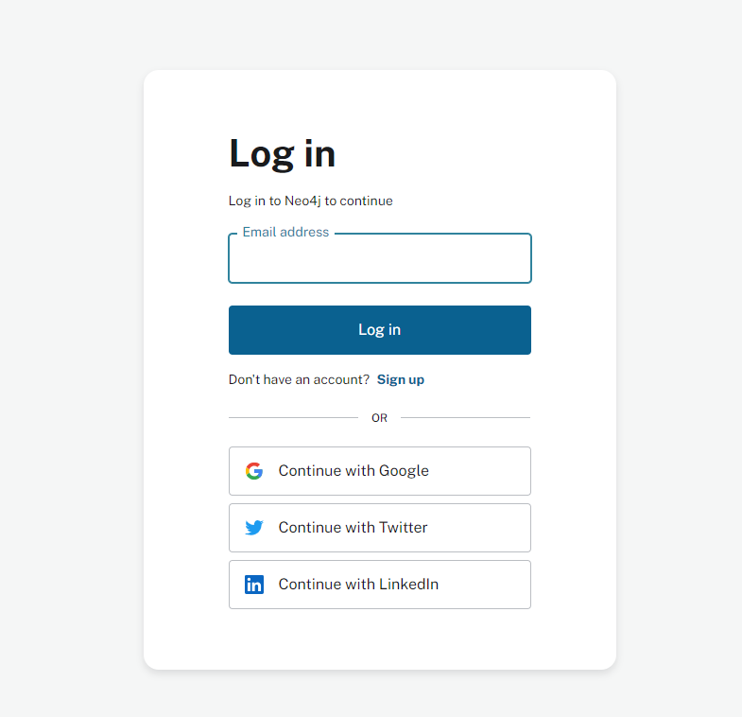
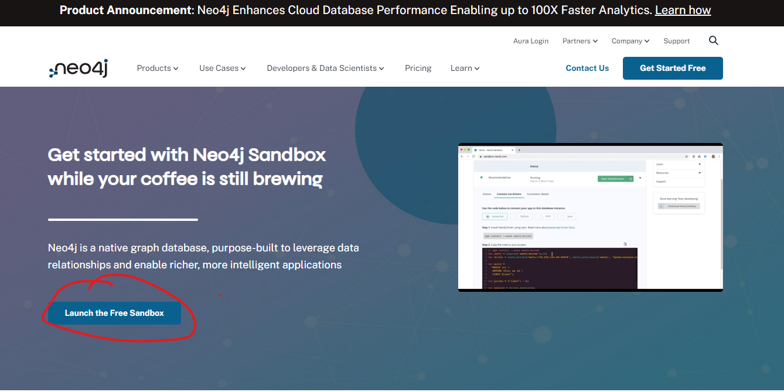
Create Your own Sandbox
Go to https://neo4j.com/sandbox/

Slide 18
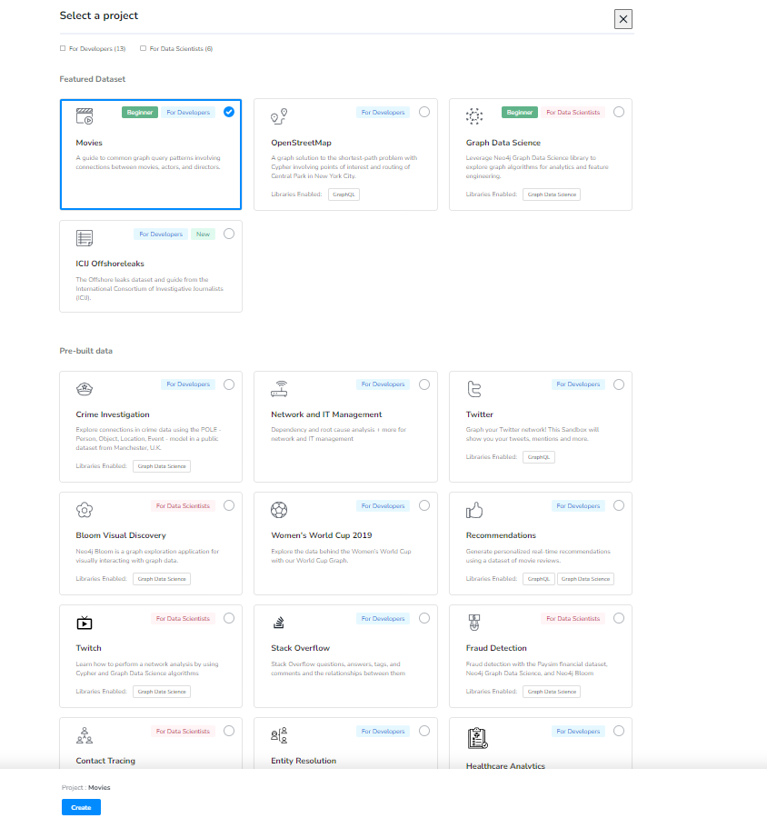
Choose a prebuild database
Choose Movies project

Slide 19
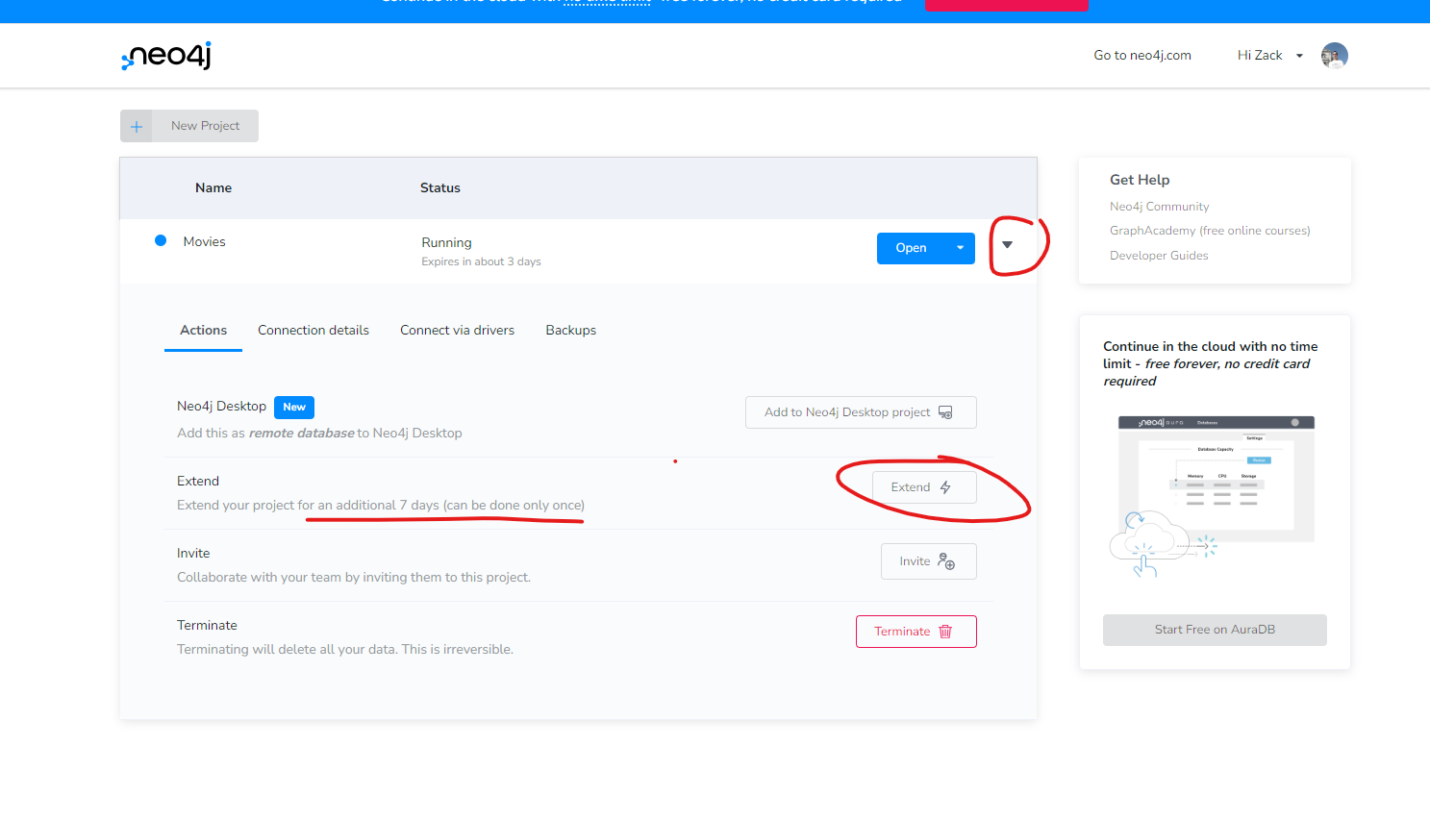
Extend your project life
By default, the project only lasts for 3 days, but you can extend it for another 7 days.

Slide 20
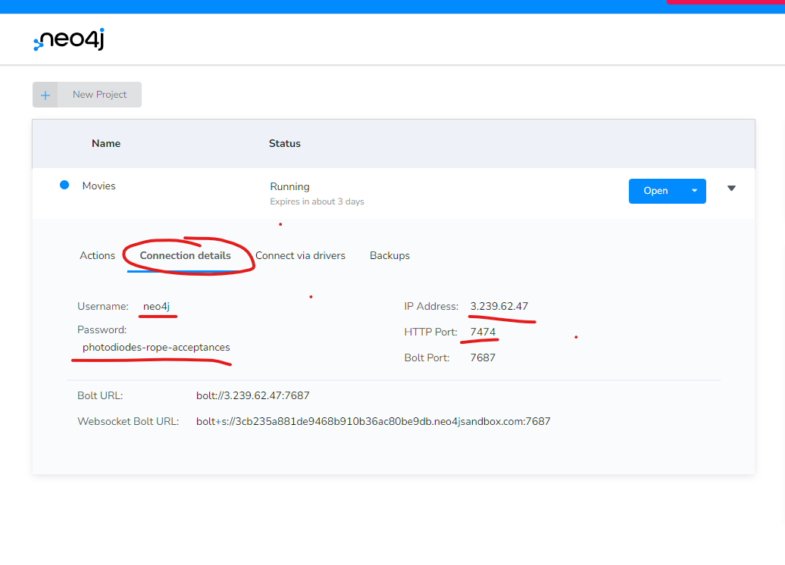
Share your database with your team
Go to Connection details
Record those infomation:
Username
Password
IP address
Http Port
Use browser to open it http://{ip address}:{port}
e.g. http://3.239.62.47:7474

Slide 21
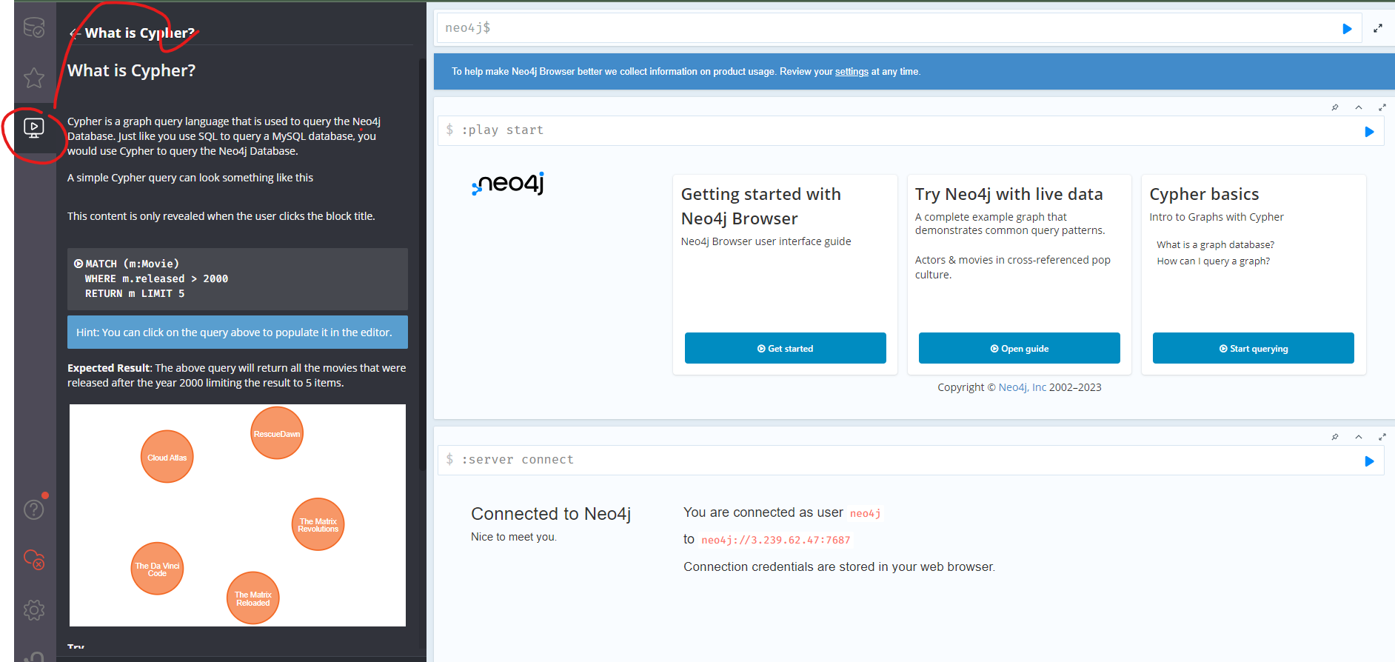
Built-in Tutorials in Sandbox
Sandboxes provide tutorials to help you understand how neo4j works
You can also view their documentation as well
https://neo4j.com/docs/cypher-manual/current
NOTE: Currently the neo4j sandbox still using the old browser, the swiching to new browser sometimes not working. Use http:// + ip from credential to use the new browser. The old browser also works well, just GUI looks different.

Slide 22
Part 3
Build your own

Slide 23
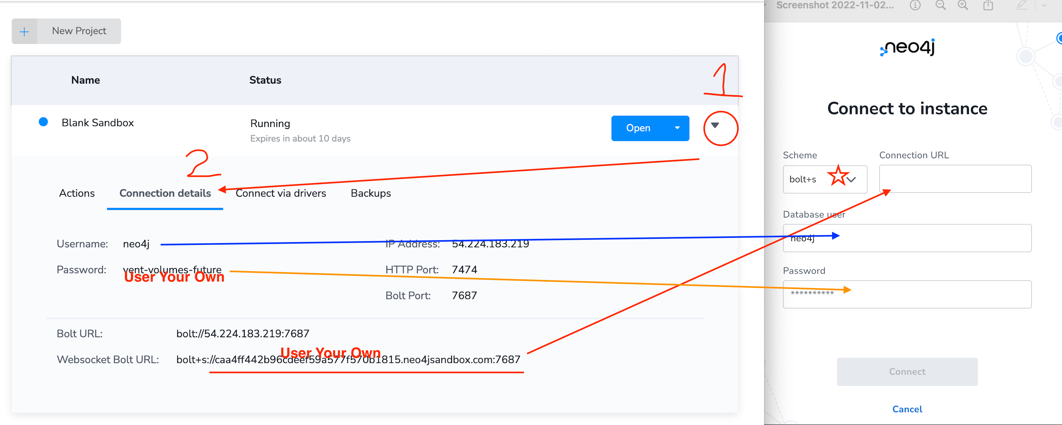
Load data with Neo4j data importer
Step 0 Create a blank database
Step 1 Download data:
https://github.com/Goodman-School/GraphDatabase/raw/main/data/W3Cnorthwind.zip
Step 2 find your db credentials
https://sandbox.neo4j.com/
Step 3 Load data
Data importer:
https://data-importer.neo4j.io/

Slide 24
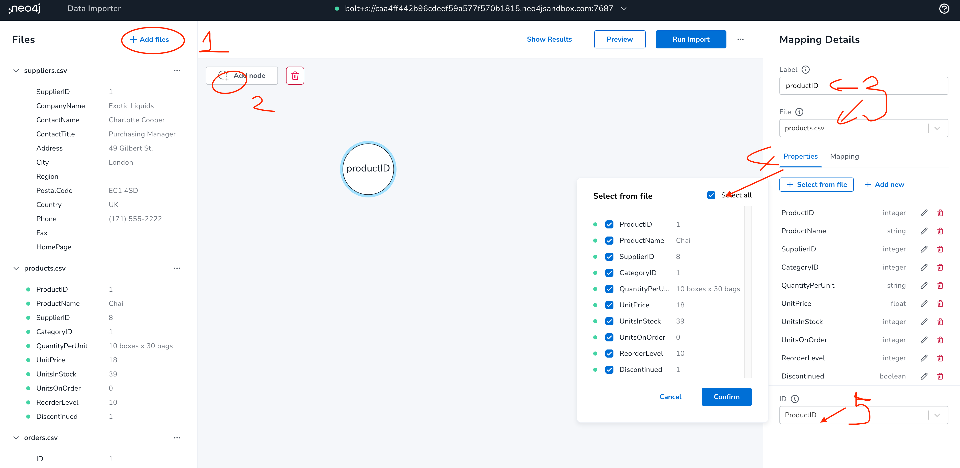
Upload files and add nodes

Slide 25
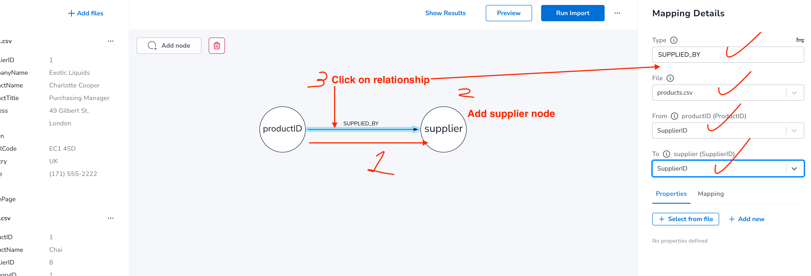
Add more nodes and relationships

Slide 26
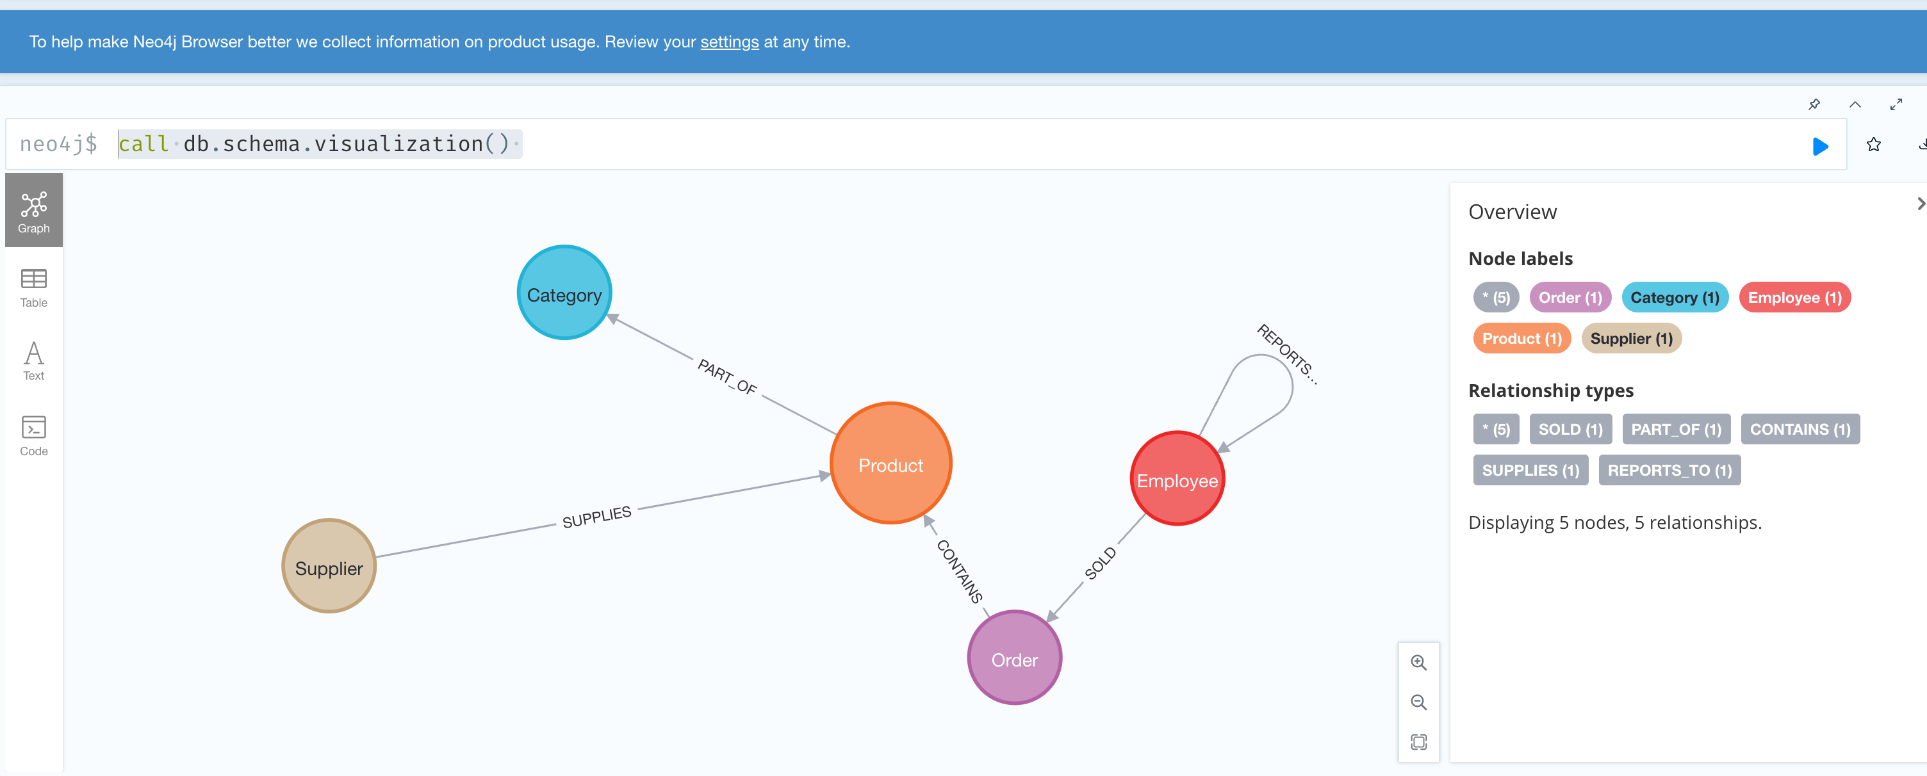
Graph Schema
call db.schema.visualization()

Slide 27
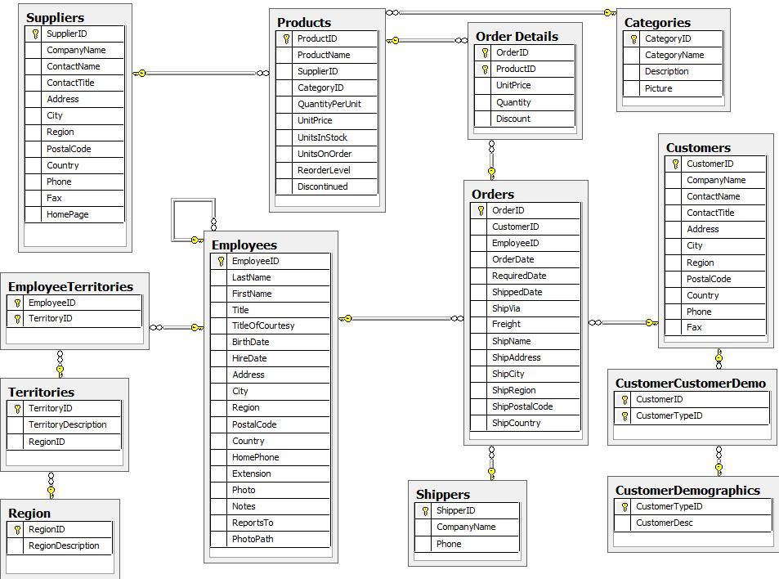
Official Tutorial (Northwind DB)
https://neo4j.com/developer/guide-importing-data-and-etl/

Slide 28
Load online data with query
Purge database:
https://github.com/Goodman-School/GraphDatabase/blob/main/queries/purgedb.cypher
Load data:
https://github.com/Goodman-School/GraphDatabase/blob/main/queries/loadnorthwind.cypher

Slide 29
Part 4
More learning resources

Slide 30
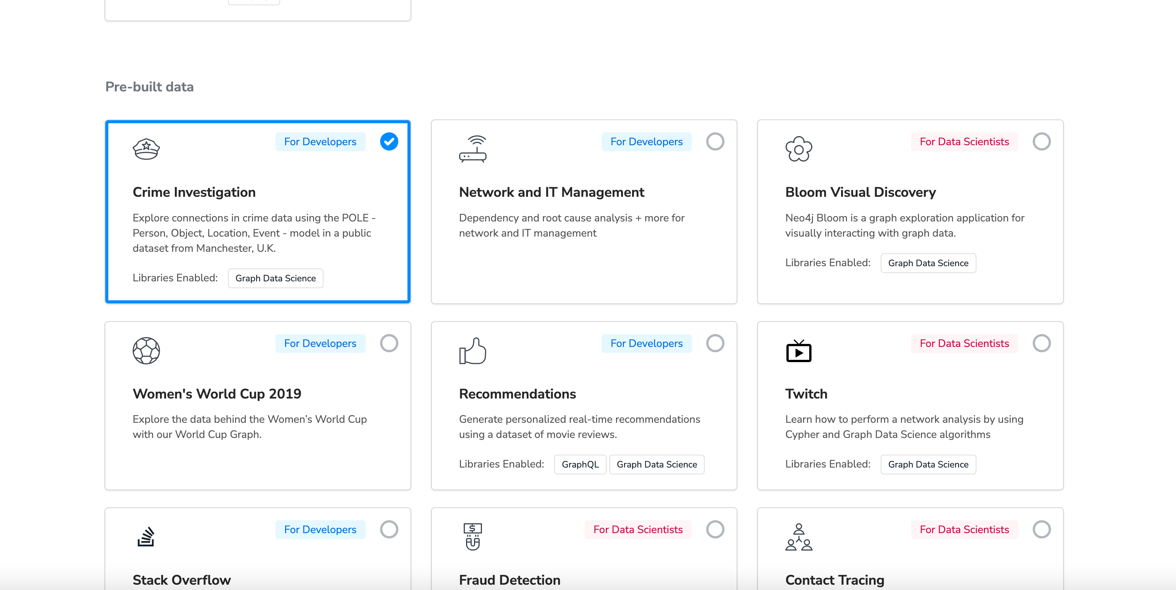
Learn more advanced technology
Follow the sanbox demo (Crime detection)

Slide 31
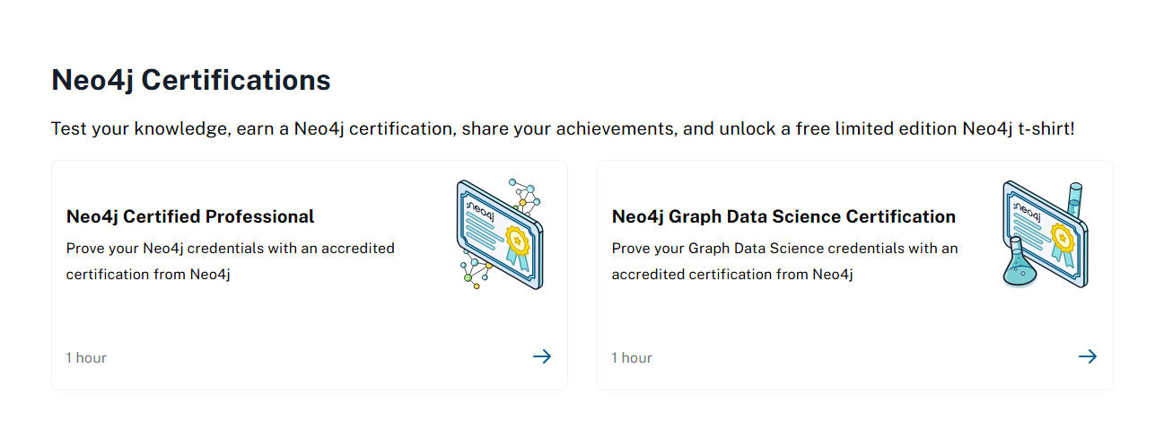
NEO4J Certificates
https://graphacademy.neo4j.com

Slide 32
Appendix: Learning Resources
Download Neo4j https://neo4j.com/download/?ref=product
Use Neo4j on sanbox https://neo4j.com/sandbox/
Neo4j data importer https://data-importer.neo4j.io/versions/latest/
Free official ebooks https://neo4j.com/books/
Get Certificate https://neo4j.com/graphacademy/neo4j-certification/

